Slide 1
User Stories and Acceptance Criteria
Adaeze Badipe

Slide 2
Learning Objectives
user stories - what/why/how
acceptance criteria - what/why/how

Slide 3
User Stories
What

Slide 4
definition: user story
A user story is a tool used in agile software development to capture the description of a software feature from an end-user perspective. The user story describes the type of user, what they want and why, A user story helps to create a simplified description of a requirement.
A user story often follows the following ‘equation’:
As a <type of user>, I want <some feature> so that <reason>
A simple example of this could be:
As an online shopper, I want to add an item to my cart, so that I can purchase it

Slide 5
user story template
 | As a <type of user>
WHAT are we building? What is the intention? | I want <some goal or objective>
 | So that <benefit/value>
WHO
are we building it for? Who is the user?
WHY
are we building it? What is the value for the customer?

Slide 6



examples: user stories
As an internet banking customer
I want to see a rolling balance for my everyday accounts
So that I know the balance of my account after each transaction is applied
As an administrator
I want create other administrators
So that I can delegate tasks
As a marketer
I want create automated email campaigns
So that I can keep evaluators engaged

Slide 7




user story checklist
Keep them short
Keep them simple
Write from the perspective of the user
Make the value/benefit of the story clear - what is the reason for the story?
Describe one piece of functionality. If you have to write and break it into 2 stories

Slide 8
User Stories
why

Slide 9
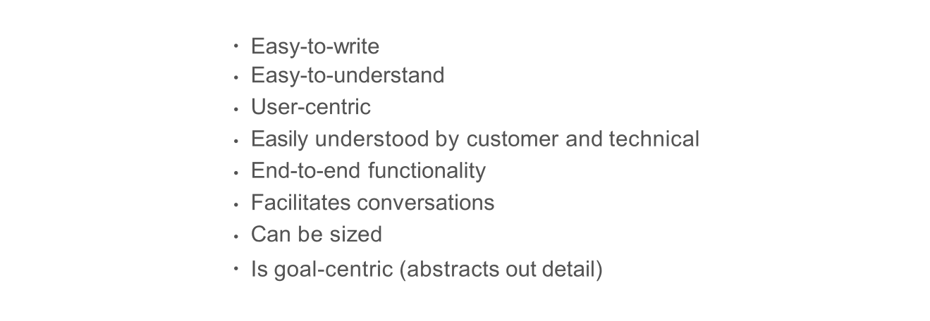
Advantages

Slide 10
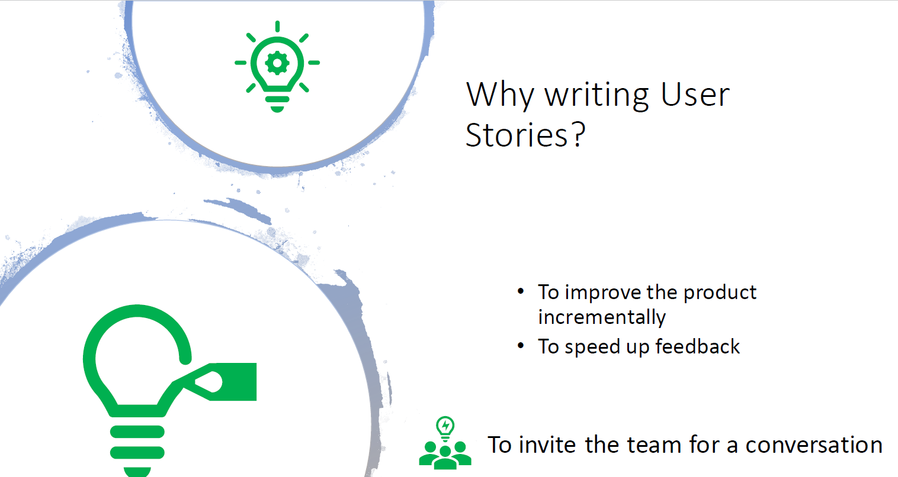

Slide 11
User Stories
How

Slide 12
Keys to good user stories
Focus on the user
Facilitate a conversation
Simple and concise
Decompose stories
SCALING 204
IIT ACADEMY

Slide 13
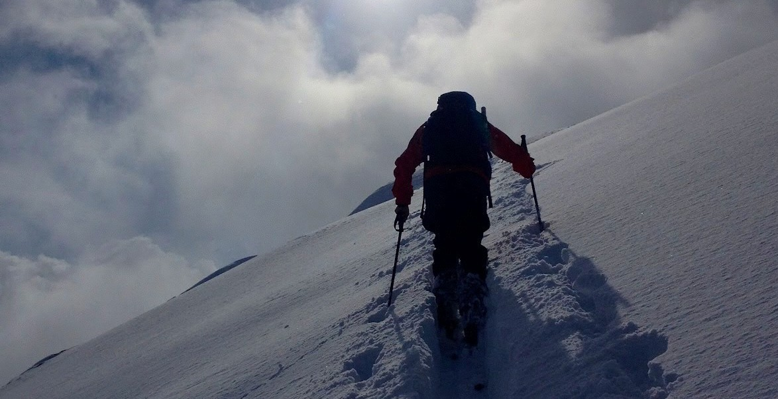
1 Focus on the user
Use an actual role, not the word “user”.
e.g. Marketing Admin, Broker, End customer, Head Office User.

Slide 14

2 Facilitate a Conversation
A story is not a specification. It is not a contract.
It does not replace dialogue.
It captures the essence of the conversation into the essential elements.

Slide 15

3 Simple and Concise
As a user, I want to sign in and connect the database to the mail API and view the email screen, so that I can view all the emails that belong to me.
Exercise – 1 minute. Come up with a better one.

Slide 16
3 Simple and Concise
Example of a concise and simple user story:
JIRA Name = “Email: View”
User Story: “As an authenticated user, I want to view my emails.”
Followed by detailed acceptance criteria

Slide 17
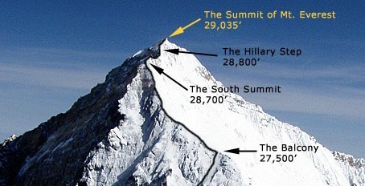
5 Decompose Stories
Start with goals – can be as big as “do marketing”.
Break down into large stories 13-100 points. Contains user- centric benefits.
Break large stories into small stories 1-8 points. Contains incremental benefits.

Slide 18
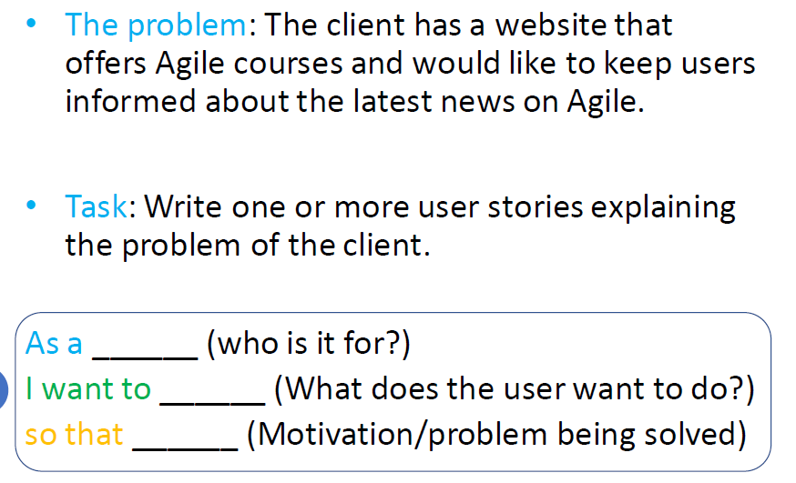
Practice: Writing User Stories

Slide 19
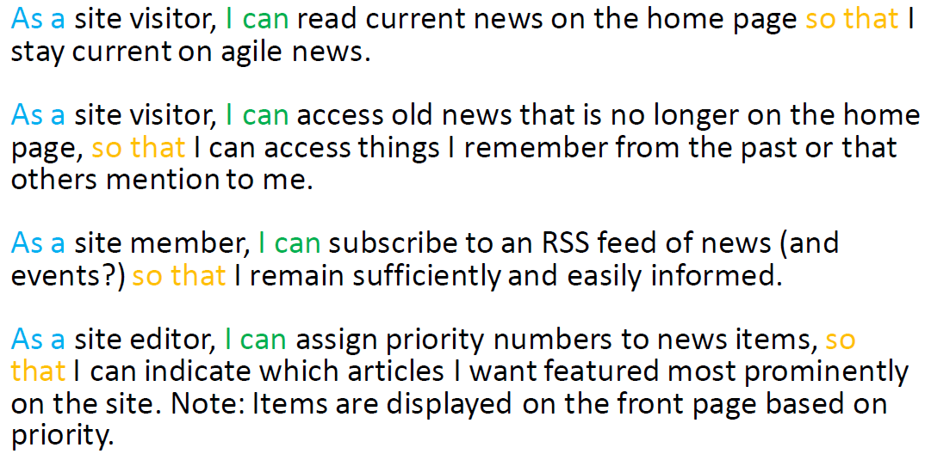
Practice: Writing User Stories Example Answer

Slide 20
Activity 1: User Stories
Use ‘Bean and Brew’ Scenario
Based on your process drawing: Identify Users
Create User Stories for identified users
***Be Comprehensive to cover all users for system: Admin, etc.
We will use this as basis for database design later

Slide 21
Acceptance Criteria
What

Slide 22
Acceptance Criteria
A pass/fail set of criteria that the user story must meet in order to be considered done.
“Conditions that a software product must satisfy to be accepted by a user, customer or other stakeholder.”
- Microsoft
“Pre-established standards or requirements a product or project must meet.”
- Google

Slide 23
Acceptance Criteria
Why

Slide 24
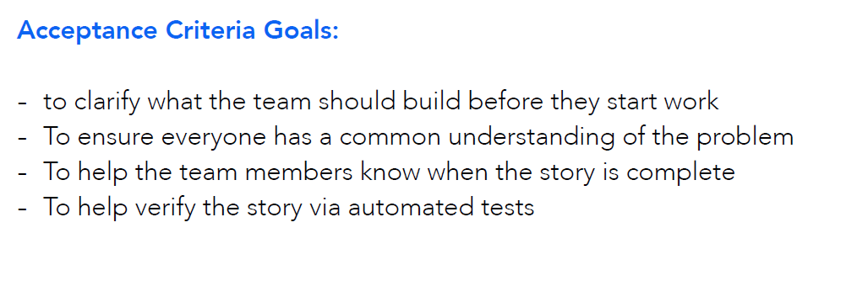
Acceptance Criteria: Why?

Slide 25
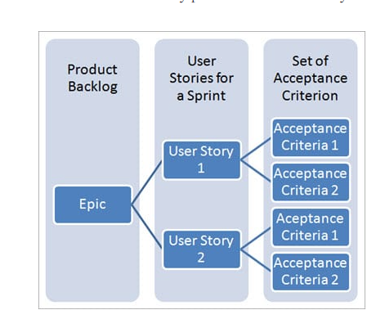
Acceptance Criteria: Why?
What is an Epic? Research this

Slide 26
Acceptance Criteria
how

Slide 27
example: acceptance criteria
As an online banking customer, I want strong a strong password, so that my credit card information is secure
Acceptance Criteria:
The password must be at least 8 characters
The password must contain at least 1 character from each of the following groups: lower case alphabet, upper case alphabet, numeric, special characters (!, @, #, $, %, ^, &, *)

Slide 28
example: acceptance criteria
As a conference attendee, I want to be able to register online, so that registration is simple and paperless
Acceptance Criteria:
A user can not submit a form without filling out all of the mandatory fields
Information from the form is stored in the registrations database
Protection against spam is working
Payment can be made via Paypal, Debit and Credit Card
An acknowledgment email is sent to the attendee after submitting the form

Slide 29

acceptance criteria should include
Negative scenarios of the functionality
Functional and non-functional use cases Performance concerns and guidelines What system/feature intends to do
End-to-user flow
The impact of a user story to other features UX concerns

Slide 30
Activity 2: Acceptance Criteria
Create an Acceptance Criteria for your User Stories for the ‘Bean and Brew’ Scenario

